Slide 1

Does DRUG A reduce fasting sugar?
BINF5210E001
Project
Prepared by: Shanmukha Sai Prakash Jeelakarra

Slide 2
Study Design & Data
A study was conducted to evaluate whether DRUG A lowers fasting sugar levels after 10 weeks.
3400 patients randomized to three groups: Low_Drug_A, High_Drug_A, Placebo
Measurements: fasting sugar level after 10 weeks
Patients were also spread across three sites: Site1, Site2, Site3
Data split across two raw files: Initial_Study and Second_Study
Sampling: SRS, sample size = 1000 (no seed)

Slide 3
Objectives
Primary Objective
To determine whether there is a significant difference in fasting sugar levels (Test_Score) among the three treatment groups.
Secondary Objectives
Examine whether the site influences the outcomes.
Check whether Group x Site interaction exists.
Perform both descriptive and inferential statistical analyses using SAS.

Slide 4
Variables (and datatypes)
Initial_Study:
PatientID (numeric)
Age (numeric)
State (char)
Length_of_Stay (numeric)
Total_Charge (numeric)
Second_Study:
PatientID (numeric)
Site (char)
Group (char) - Low_Drug_A / High_Drug_A / Placebo
Test_Score (numeric) - fasting sugar (post 10 weeks)

Slide 5
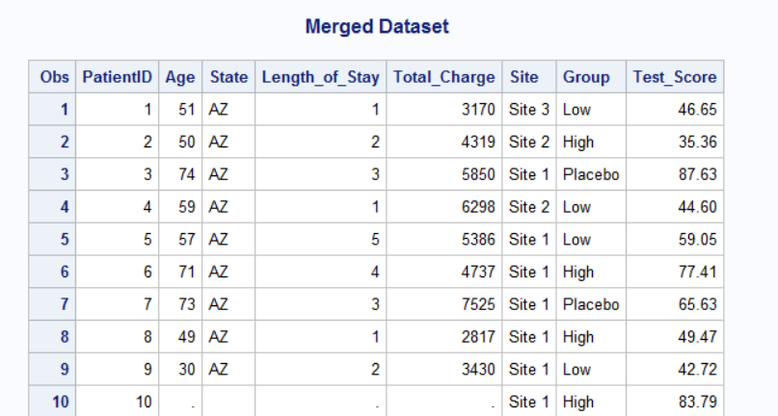
Data Preparation
Step 1: Sorting and Merging Raw Files
Sorted and Merged Initial_Study_Project1 and Second_Study_Project1 using PatientID.

Slide 6
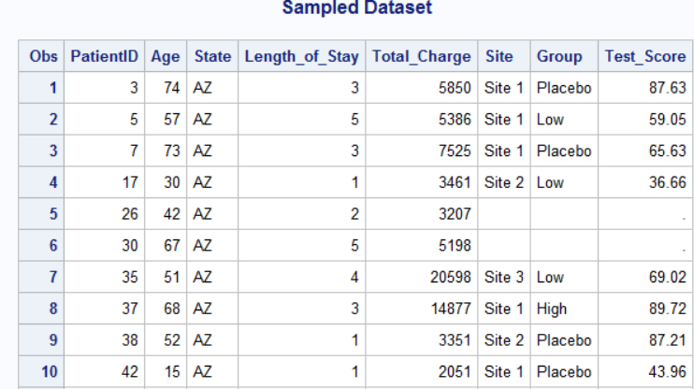
Data Preparation
Step 2: Sampling
Applied Simple Random Sampling (SRS)
Sample size = 1000 (No seed used)

Slide 7
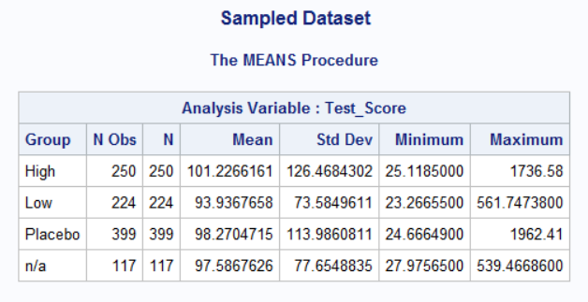
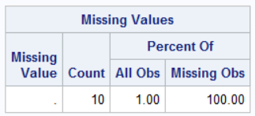
Data Preparation
Step 3: Data Cleaning
Removed records where test_Score was missing (.),Group = "n/a"
After cleaning, the final dataset used for analysis contained 863 observations

Slide 8
Research Question & Hypotheses
Research Question:
Is there a significant difference in mean fasting sugar levels (Test_Score) among the three treatment groups - High Drug A, Low Drug A, and Placebo?
Null Hypothesis (H₀): There is no difference in mean Test_Score between the High Drug A, Low Drug A, and Placebo groups. μHigh = μLow = μPlacebo
Alternative Hypothesis (H₁): There is at least one difference in mean Test_Score among the three groups. At least one μ differs.
Tested this using One-Way ANOVA.

Slide 9
Statistical Methods & Assumptions
Primary test: One-way ANOVA (PROC ANOVA / PROC GLM) comparing Test_Score by Group.
If ANOVA significant, post-hoc pairwise comparisons (Tukey) to find differing groups.
Check assumptions: normality (PROC UNIVARIATE), homogeneity of variances (Levene's test via HOVTEST).

Slide 10
SAS Code
/* Merge, sample (SRS), run ANOVA & GLM */
Proc surveyselect Data=Merged Method=SRS Sampsize=1000 Out=Sampled_Data; run;
Proc means Data=Sampled_Data n mean std min max; class Group; var Test_Score; run;
Proc univariate Data=Sampled_Data normal; var Test_Score; run;
Proc Anova Data = Analysis_Data; class group; model test_score = group; means group / tukey; run;
Proc glm Data=Analysis_Data; class group; model Test_Score = group; means group / hovtest=levene; run;

Slide 11
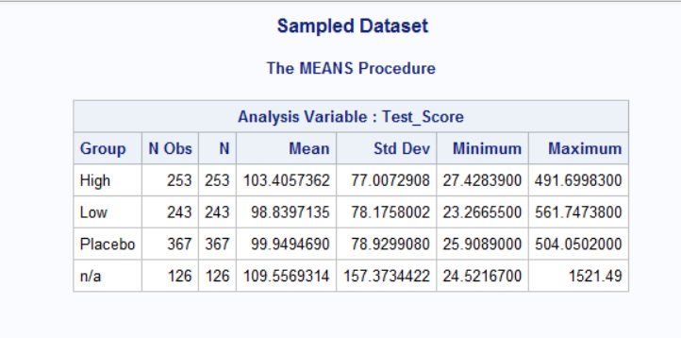
Descriptive Statistics (PROC MEANS)
Interpretation:
Means of all three groups are very close.
Standard deviations are large, indicating high variability in test scores.
Nothing in this table suggests strong group differences.

Slide 12
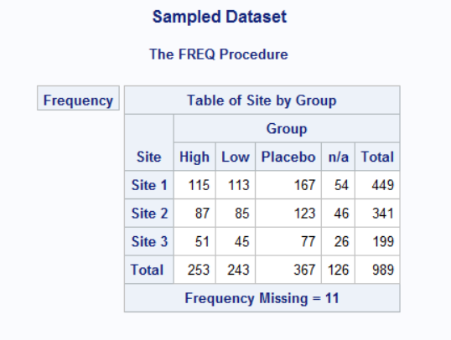
PROC FREQ (Site x Group Table) Sample Distribution Across Sites
Observations:
Site 1 has the most participants (449), Site 3 the least (199).
Each site includes all 3 treatment groups.
The distribution is reasonably balanced but not identical.
Interpretation:
This suggests:
The study design allocated patients across sites adequately.
No site appears empty for any treatment group.
Supports later use of Two-Way ANOVA (GLM) with Site included as a factor.

Slide 13
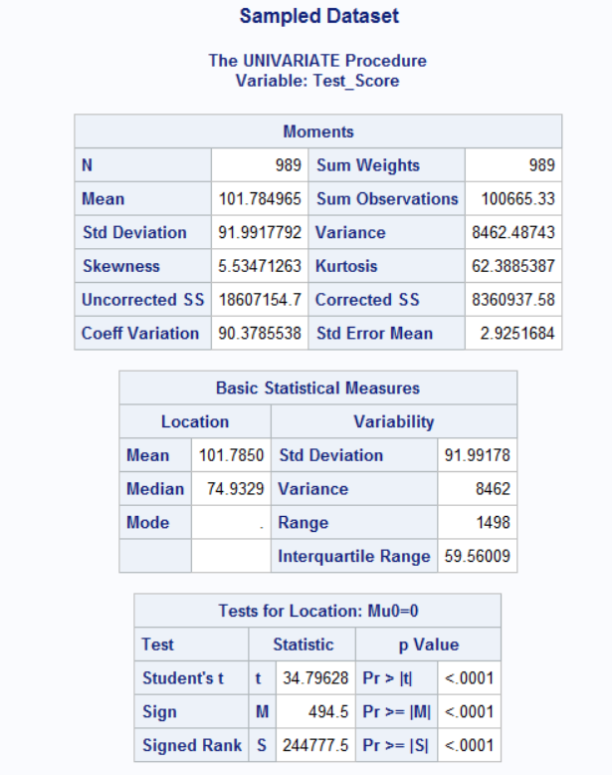
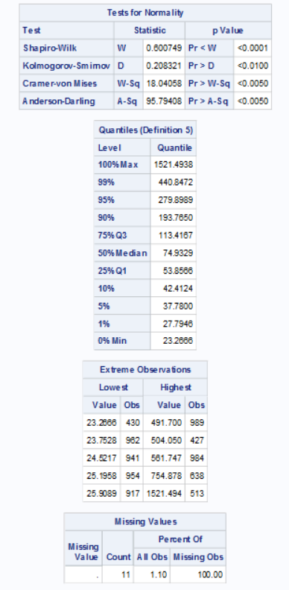
PROC UNIVARIATE - Normality Distribution Check

Slide 14
PROC UNIVARIATE - Normality Distribution Check
Key results:
Shapiro-Wilk W = 0.6007, p < 0.0001
KS, CvM, AD also p < 0.01
Conclusion: distribution is NOT normal
But we are allowed to assume normality to proceed with ANOVA/GLM.
Other observations:
Mean = 101.78, Median = 74.93 (skewed right)
Skewness = 5.53, Kurtosis = 62.39 indicates strong right tail
Extreme max = 1521, min = 23
Interpretation:
The variable is heavily skewed, but due to the instructions, we proceeded with ANOVA, assuming normality.

Slide 15
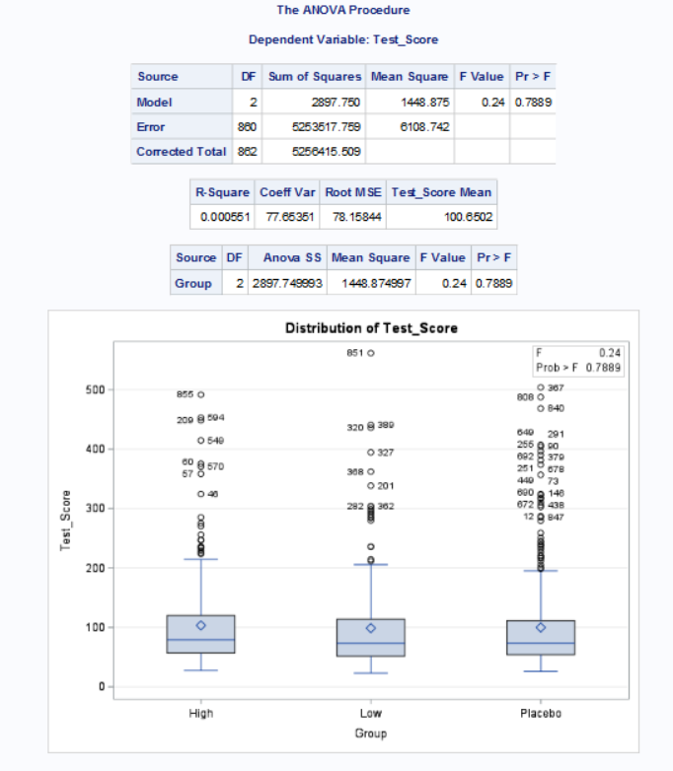
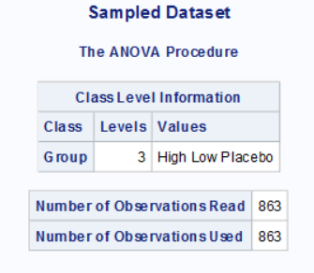
Inferential statistics: One-Way ANOVA (PROC ANOVA)

Slide 16
One-Way ANOVA (PROC ANOVA)
Interpretation:
p = 0.789 → Not significant.
The model explains 0.05% of the variation (essentially 0).
Conclusion: No statistically significant difference in Test_Score between High, Low, and Placebo groups.

Slide 17
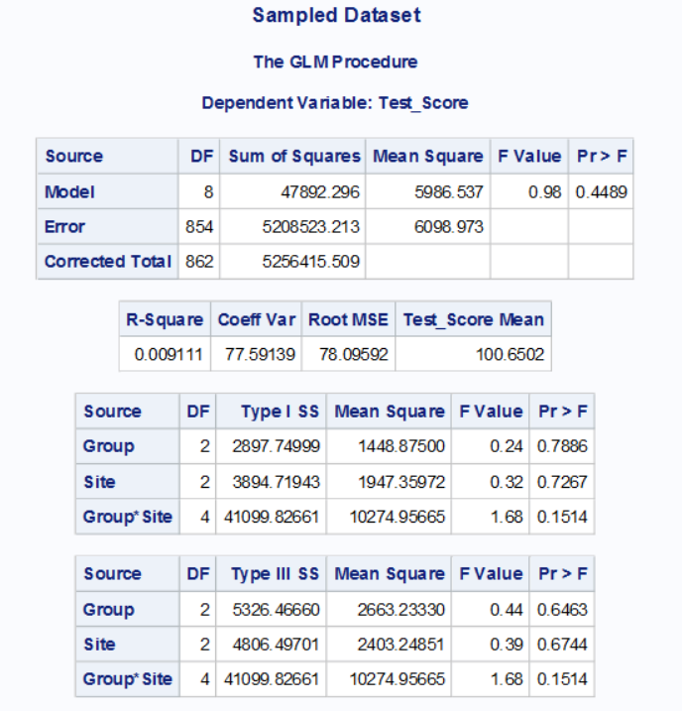
PROC GLM (Two-Way Model: Group, Site, Interaction)

Slide 18
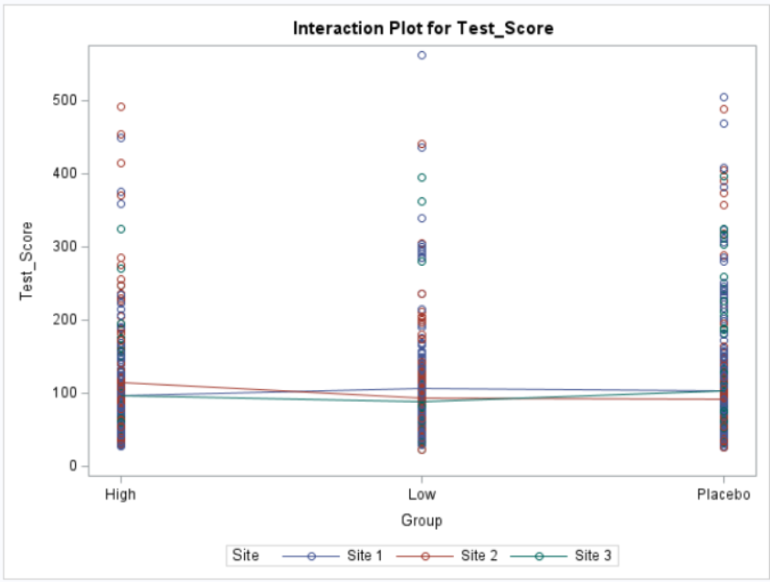
PROC GLM (Two-Way Model: Group, Site, Interaction)

Slide 19
PROC GLM (Two-Way Model: Group, Site, Interaction)
Interpretation:
Group p = 0.646 That means Not significant
Site p = 0.674 That means Not significant
Interaction p = 0.151 That means Not significant
Meaning:
No treatment difference across sites.
No site-level differences in test scores.
No interaction (i.e., drug does NOT work differently across sites).
The two-way ANOVA confirms the earlier one-way ANOVA.

Slide 20
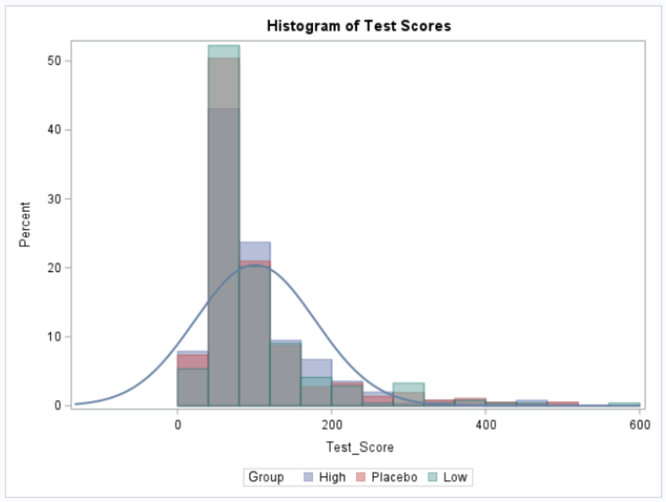
PROC SGPLOT - Histograms

Slide 21
PROC SGPLOT - Histograms
Interpretation:
All three groups have heavily skewed distributions.
All groups show overlapping shapes that means visually confirms no meaningful difference.
Large variability and long right tails match UNIVARIATE findings.

Slide 22
FINAL RESULTS SUMMARY
Primary Finding:
There is no evidence that DRUG A (either low or high dose) reduces fasting sugar levels compared to Placebo.
Evidence:
ANOVA p = 0.7889
GLM (Type III) p = 0.6463
Site effect also NS (p = 0.6744)
Interaction NS (p = 0.1514)
Means for all groups ~ 100

Slide 23
Conclusion
The study does not support the claim that DRUG A is effective in lowering fasting sugar levels. No statistical difference between High Drug A, Low Drug A, and Placebo groups.

Slide 24
Limitations
The dataset showed severe skewness and extreme outliers.
Normality assumptions were forced (as per instructor’s note).
Only 1000 records were sampled from 3400 (sampling variability).
Some records had missing or n/a groups, reducing sample size.
Other clinical factors (medications, comorbidities, diet) not included.

Slide 25
Acknowledgment
Instructor: Dr. Riddhi Vyas
Course: BINF5210E001 HLTH DATA ANLYTICS W SAS
Tools Used: SAS 9.4, PowerPoint
- Thank you!

